Slide 1
Anticipating threats in natural Systems
UNCLASSIFIED
Task Title: Integrated Risk-Based Environmental Modeling of Extreme Coastal Weather Events
Environmental Systems Modeling Team:
Dr. Todd Steissberg (ERDC-EL)
Mr. John Kucharski (ERDC-EL)
Dr. Jennifer Olszewski (ERDC-EL)
Ms. Marriah Abellera (USACE-IWR)
Dr. Billy Johnson (LimnoTech, Inc.)
Dr. Chuck Downer (ERDC-CHL)
Ms. Lauren Melendez (ERDC-EL)
External Collaborators:
Scott Steinschneider (Cornell)
Sudarshana Mukhopadhyay (Cornell)
Peter Ruggiero (Oregon State University)
Jon Herman (UC Davis)
ACTIONS IPR Meeting, September 9, 2022

Slide 2
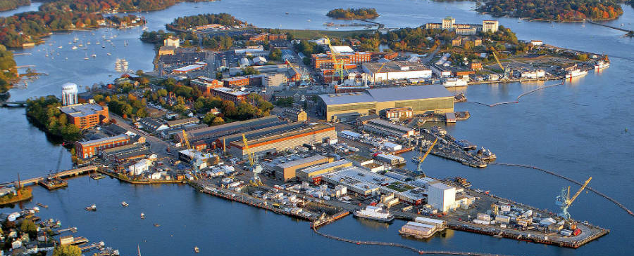
Considerations
Coastal margins are comprised of a complex network of terrains, including intertidal wetlands and mudflats of national significance, which serve as habitat for endangered riparian and aquatic species. These areas, like other coastal zones, are exposed to a web of compound hazards that affect water quality, environmental quality, and maneuverability over the terrain. Challenges include interannual periods of low flow, which impact salinity, soils, vegetation, and water supply, as well as periods of anomalously high water levels. Both high and low water levels are tied to interlinked phenomena that occur on hourly to interannual time scales.

Slide 3
Objective
The objective of this task to develop integrated models that simulate water levels and flow, water quality (salinity, nutrients, temperature, and contaminants), vegetation dynamics (in collaboration with our ACTIONS partners), land use change, and dynamic adaptation pathways. Risk-based time series of extreme coastal events will drive water quality and land use impact models, from which a full understanding of vulnerabilities and dynamic adaptation pathways will be developed. These integrated models will enable military installation planners and managers to assess and respond to risks to natural infrastructure in their coastal settings.

Slide 4
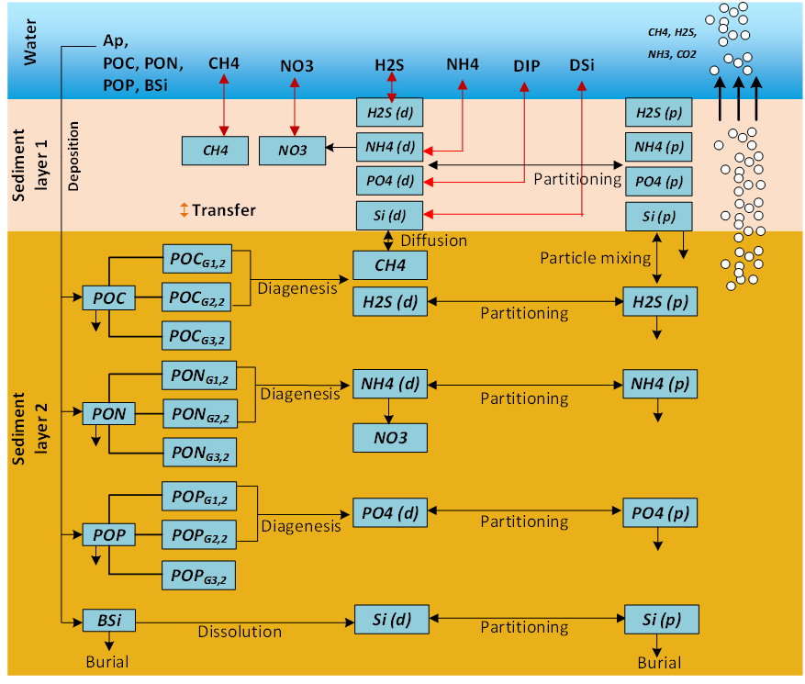
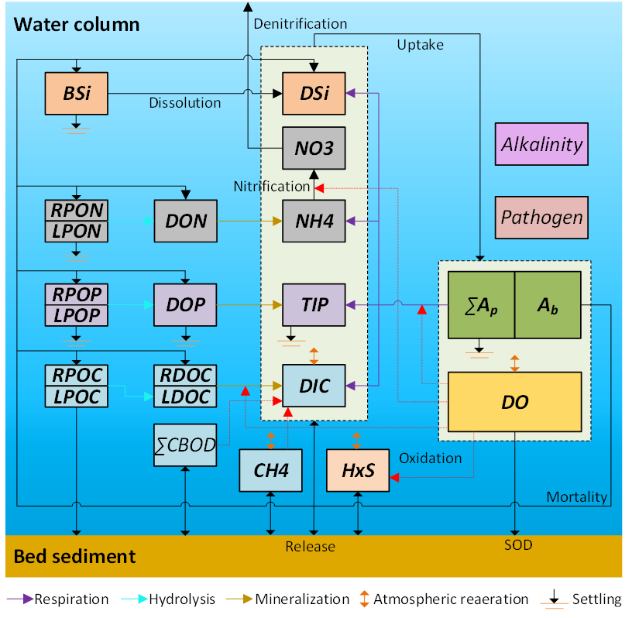
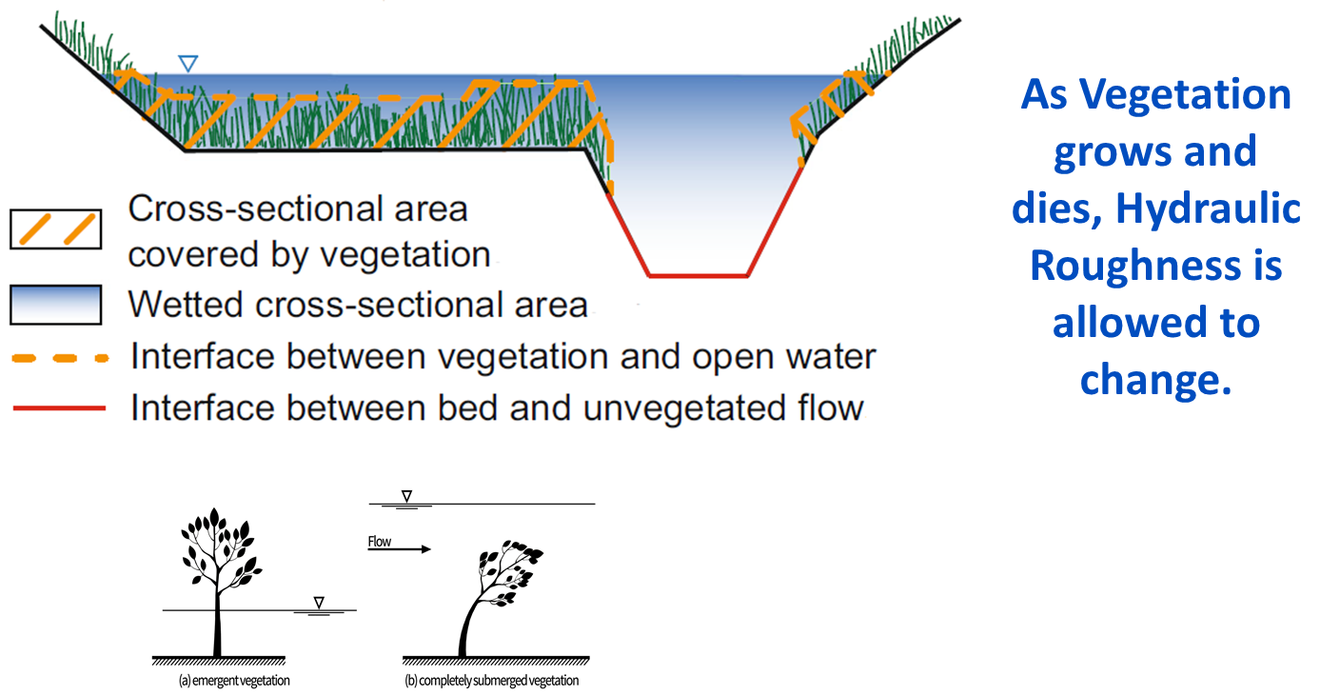
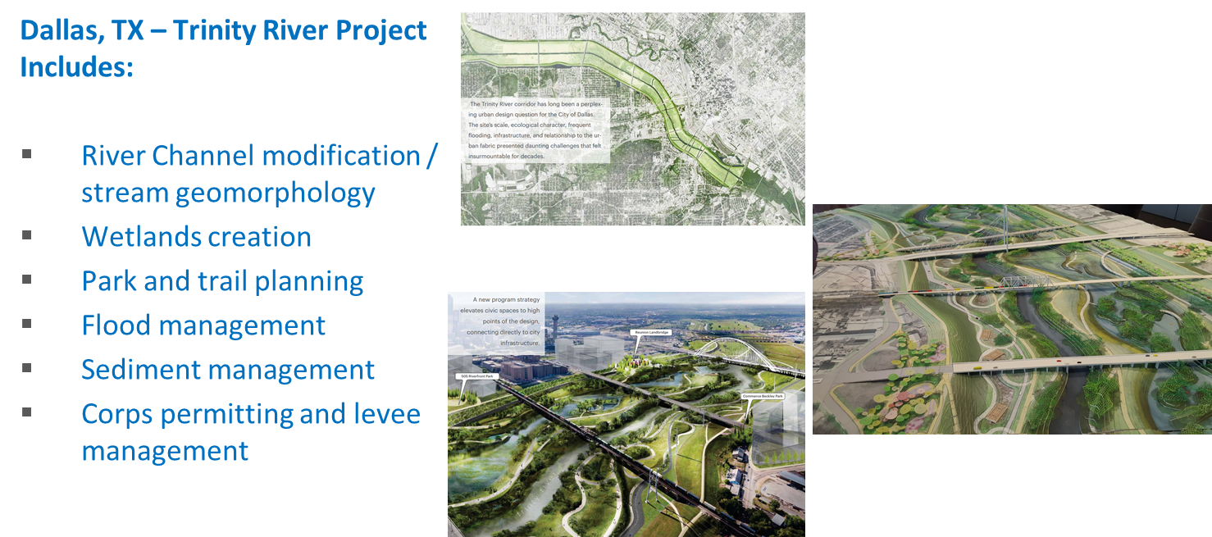
Objective: Integrated Hydro-Ecological Modeling
Develop integrated hydro-ecological models that simulate the complex and dynamics interactions between hydrology, meteorology, climate, water quality (salinity, temperature, nutrients), soil chemistry, vegetation, and morphology processes.
Models will enable evaluating system vulnerabilities and identifying adaptation pathways to improve the resilience of coastal ecosystems to environmental stresses, such as increasing frequency and intensity of coastal storm surges and extreme precipitation events, rising sea levels, decreasing freshwater flows, and increased salinity intrusion.

Slide 5
Objective: Integrated Hydro-Ecological Modeling
Models will incorporate process descriptions from the other ACTIONS teams to provide the ability to simulate future conditions and provide more rigorous design tools for construction of Nature Based Features (NBF).
Provides tools for Engineering with Nature (EWN) projects that accurately simulate future conditions with and without projects at the temporal and spatial scales necessary for engineering design

Slide 6
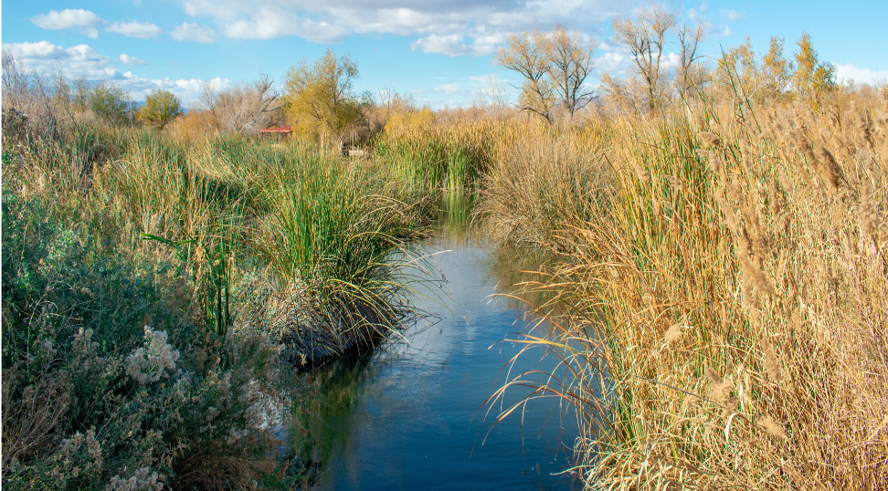
Environmental Modeling Tasks
Environmental Forcing Models
Simulate combinations of environmental forcing conditions to generate a plausible range of coastal hazards while preserving the complex interaction between contributing processes
Water Quality Models
Ecological Models
Relate indicator species responses - e.g., growth and health to water balance components, soil conditions, surface and subsurface water quality - to environmental forcing
Simulate watershed and riverine water quality and contaminant release from soils under saline conditions

Slide 7
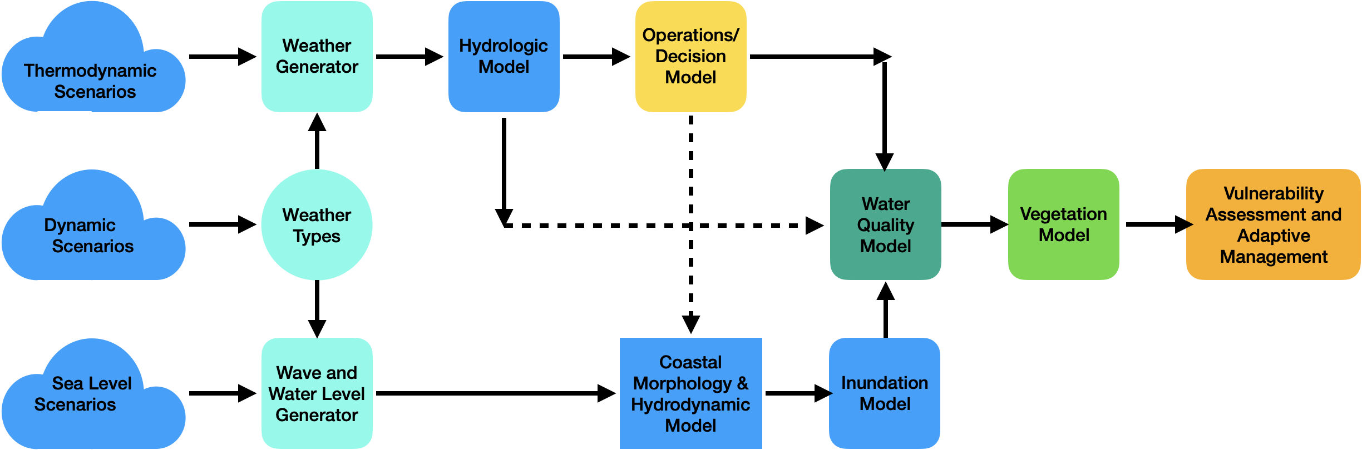
System Modeling Framework

Slide 8
FY22 Accomplishments
Environmental Forcing Model and Case Study (Tasks 4, 6, 8)
We used paleo-reconstructions to generate long-term simulations of daily water levels that model wind, tides, fluvial inflows, storm surge, non-tidal residuals, etc., in an internally consistent manner.
Findings
Coastal and estuary environments are defined by water levels, which are in turn influenced by a myriad of correlated and independent variables: relative sea level rise, tides, wind, surge events, and other anomalies that occur on interannual, seasonal and sub-seasonal time scales.
Extreme high and low water levels are rarely the result of a single extreme variable (e.g., tide, surge, etc.), but instead occur when multiple correlated factors (i.e., surge, and non-tidal still water residuals, fluvial inflows) and independent variables (i.e., tides at their extremes) interact.
Coastal water level records are too short to allow good inferences about the joint distribution of the various factors that drive coastal and estuary water levels.
These water level simulations improve our understanding of coastal water level variability and vulnerability, and they are thus critical to our understanding of the biological processes (such as plant growth and mortality) that play key roles in determining the elevation of land and water along coastal margins.
These simulations are being used to understand and model the survivability and function of coastal and estuary environments under natural variability and climate change.
These tools that simulated water levels may be applied by our LSU partners in studies in the Atchafalaya and Terrebonne watersheds in FY23.

Slide 9
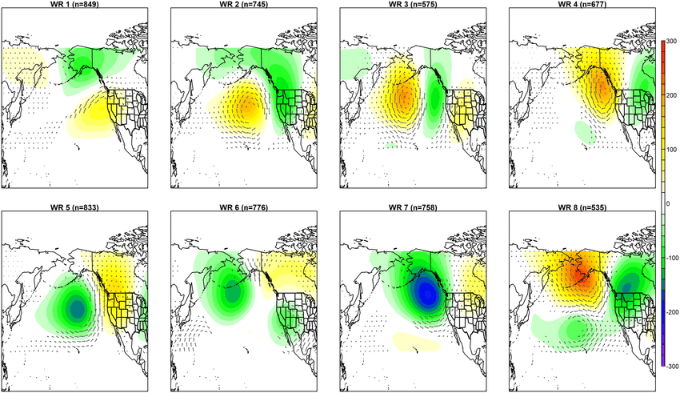
FY22 Accomplishments
Environmental Forcing Model and Case Study (Tasks 4, 6, 8)

Slide 10
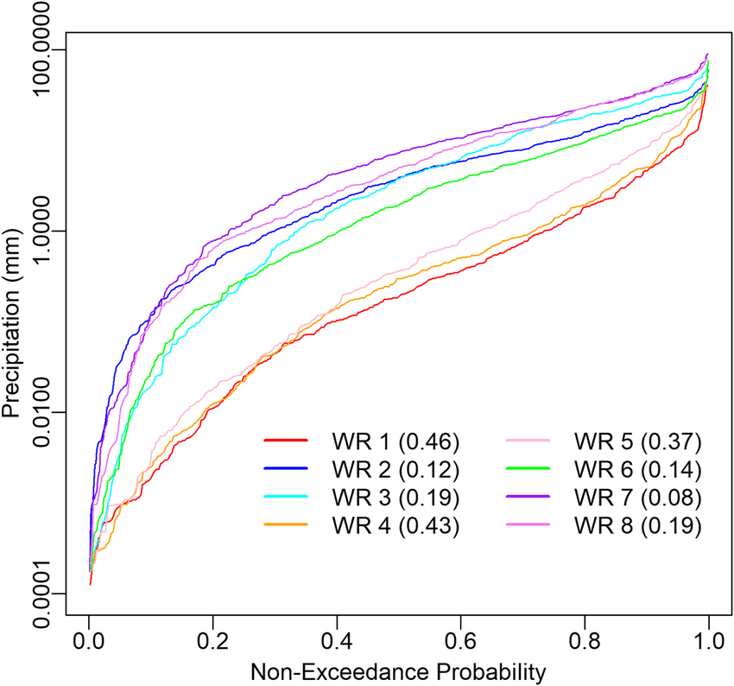
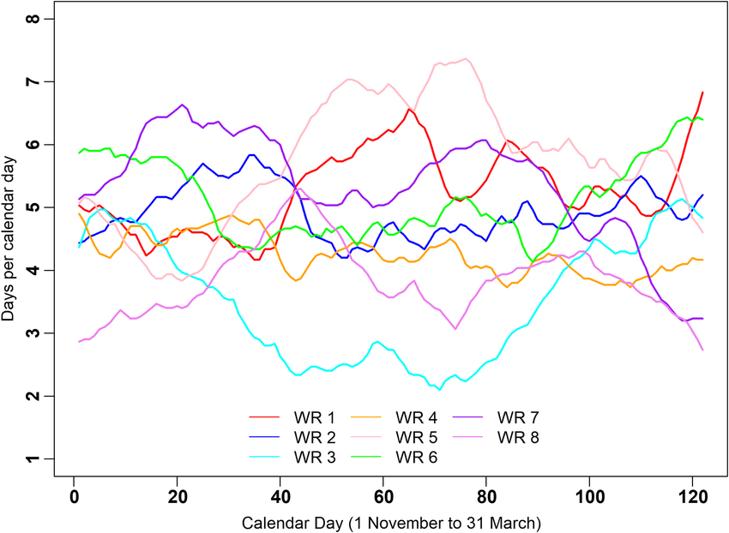
FY22 Accomplishments
Environmental Forcing Model and Case Study (Tasks 4, 6, 8)

Slide 11
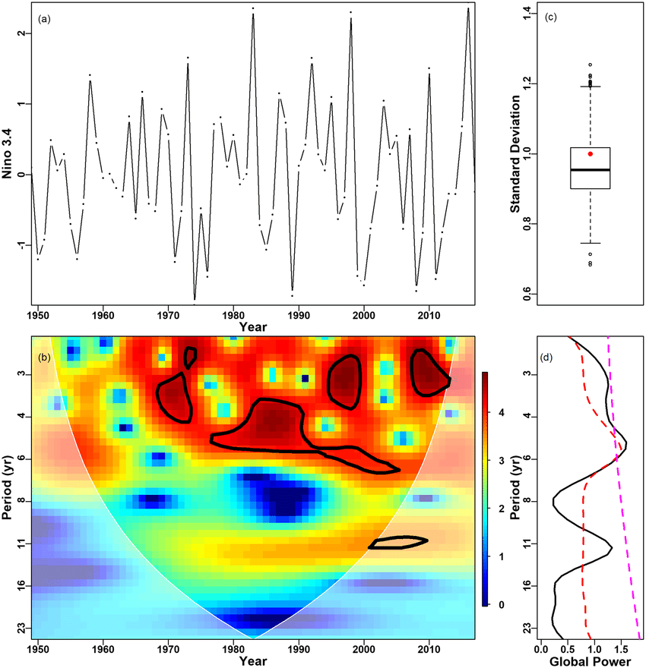
FY22 Accomplishments
Environmental Forcing Model and Case Study (Tasks 4, 6, 8)

Slide 12
FY22 Accomplishments
Water Quality Model (Task 3, 5, 7)
Water quality capability development:
ClearWater/HEC-RAS-2D
Model framework
Contaminant modeling
WEBMOD (USGS’s Water, Energy, and Biogeochemical Model) flows linked with HEC-RAS-2D and water quality outputs linked with ClearWater model
Data storage and exchange library to link the hydrologic and hydraulic (H&H) models (GSSHA and HEC-RAS) with the water quality and vegetation models.
GSSHA contaminant modeling on hold until FY23
Salinity (X2) modeling and analysis
Research questions refined
Historical analysis completed
System model assembled to analyze salinity under multiple climate forcing conditions (tides, sea level rise, etc.)

Slide 13
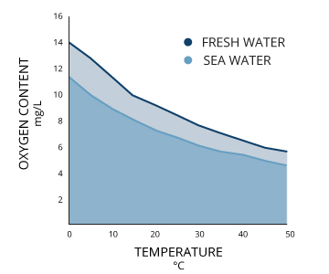
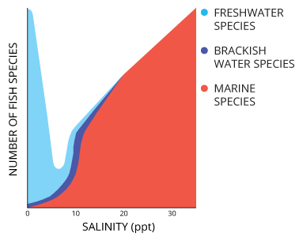
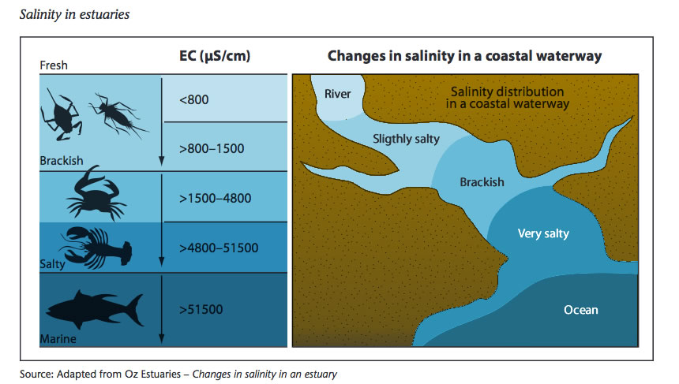
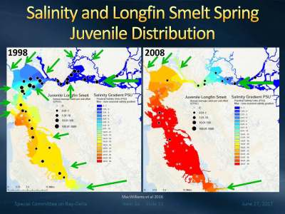
Salinity Gradients: Water Quality and Aquatic Ecosystems
Notes:
Sources:
Fondriest Environmental, Inc. “Conductivity, Salinity and Total Dissolved Solids.” Fundamentals of Environmental Measurements. 3 Mar 2014. Web. https://www.fondriest.com/environmental-measurements/parameters/water-quality/conductivity-salinity-tds/
Dr. Shawn Acuna, Bay Delta Committee, https://mavensnotebook.com/2017/07/06/metropolitans-special-committee-on-the-bay-delta-longfin-smelt-science-efforts-california-water-fix-update/
Bay Delta Live, https://www.baydeltalive.com/-/object.v2.php?id=7781

Slide 14
FY22 Accomplishments: Salinity Modeling and Analysis (Task 7)
Research Questions:
Paleo Salinity Analysis
Understanding natural variability in Salinity (X2) over a 500-year record
Understanding man-made disturbances on natural variability on X2
Demonstrate the seasonal variability in the salinity prior to extensive upstream development factoring multiple drivers, i.e., Mean Sea Level (MSL) and tidal influence
Salinity (X2) under future scenarios
Projecting X2 under future climate scenarios
What range of Sea Level Rise (SLR) becomes a primary driver for X2?
Probable range of X2 under compound conditions (SLR, drought)
Optimization for X2 under Future Scenarios
How can we use systems operations to manage X2 under future climate extremes?
Apply a systems approach to manage water demands for multiple objectives (water supply, land use, and ecosystems).
Use long-term records in paleo X2 analysis to look at environmental goals and assessing change.

Slide 15
FY22 Accomplishments: Salinity System Model (Task 7)
Stochastic Weather Generator
Precipitation
Hydrologic Model
Reservoir inflows
Systems Operations model
DTO
X2 Model
TESLA/COSMOS
Storage estimates
Temperature
Water Levels
Tidal Range
X2 position
Demands for releases to maintain X2

Slide 16
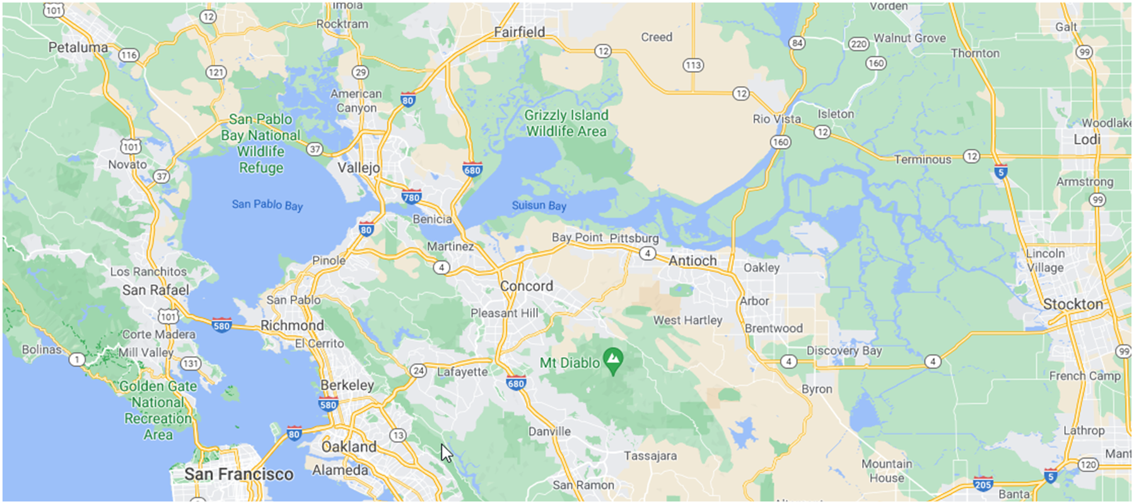
FY22 Accomplishments: Salinity Case Study Site (Task 7)

Slide 17
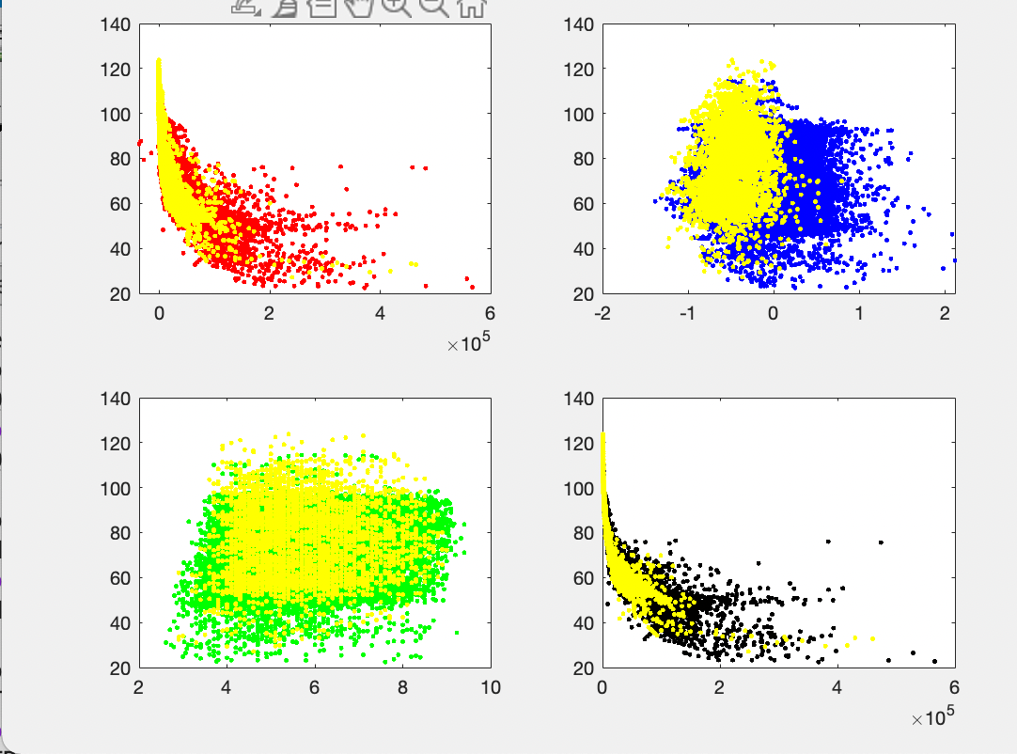
FY22 Accomplishments: Historical Salinity Analysis (Task 7)
Relationship of Salinity (X2) to various drivers that influence salinity in the Delta
X2
QOut
MSL
X2
Tidal Range
G

Slide 18
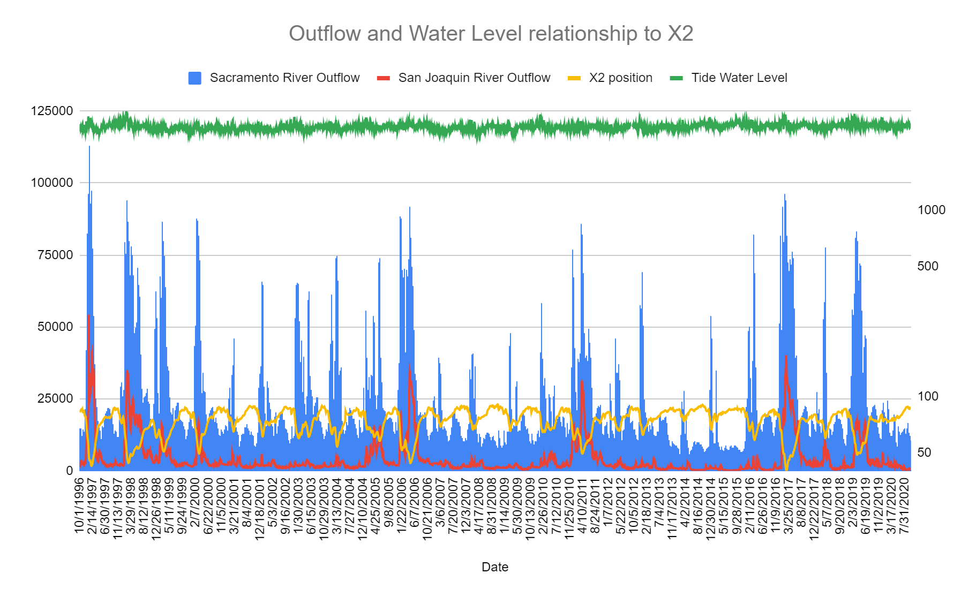
FY22 Accomplishments: Historical Salinity Analysis (Task 7)
Flow (cfs)
Distance (km)

Slide 19
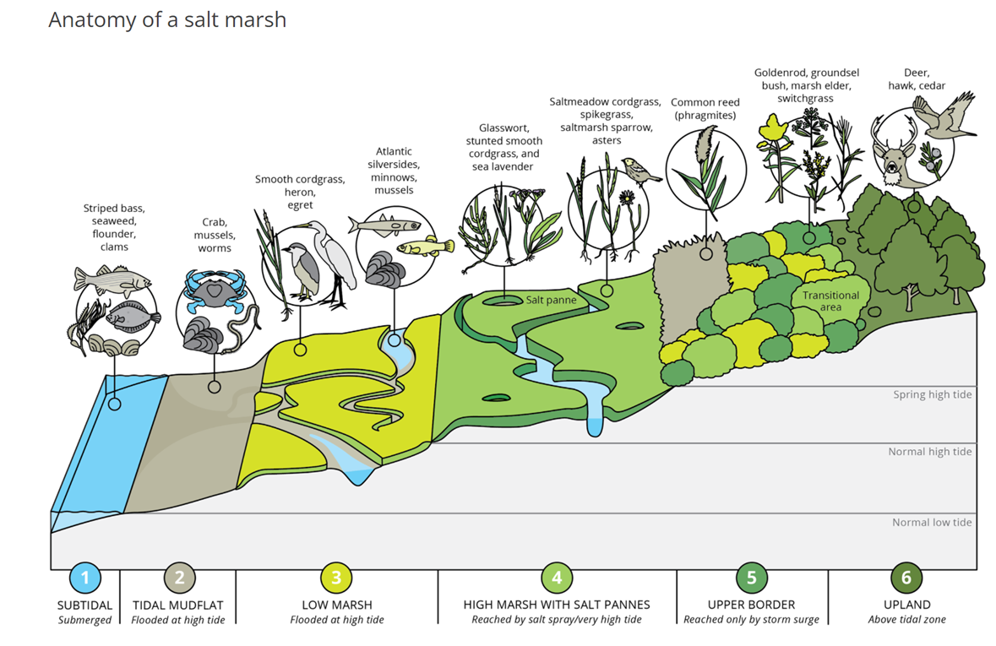
FY22 Accomplishments
Hydro-Ecological Salt Marsh Model (Task 11) – Revised Task
Completed scope of work
Completed initial design

Slide 20
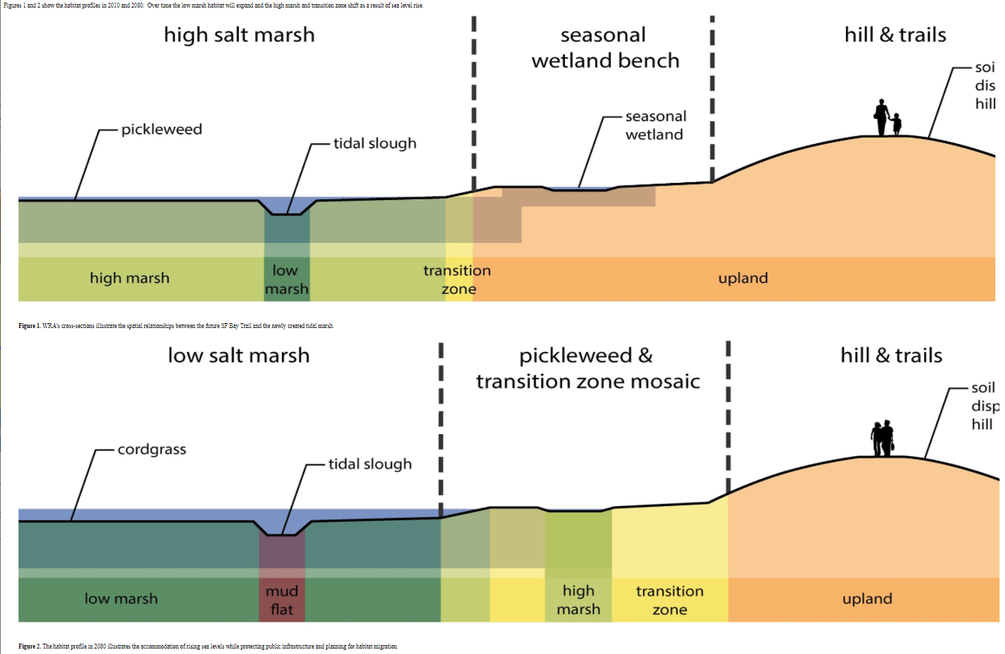
FY22 Accomplishments: Hydro-Ecological Salt Marsh Model Objective
Objective: Develop a “unit” salt marsh model that can demonstrate how to:
Design salt marshes for specific performance objective(s) that are robust to range of potential future sea level and sediment input conditions
Quantify performance using measurable performance metric(s)
Identify those marsh parameters (e.g., platform depth, vegetation species dominance, etc.) to which performance is most sensitive to.
Lead to the development of generalized salt marsh model design guidelines

Slide 21
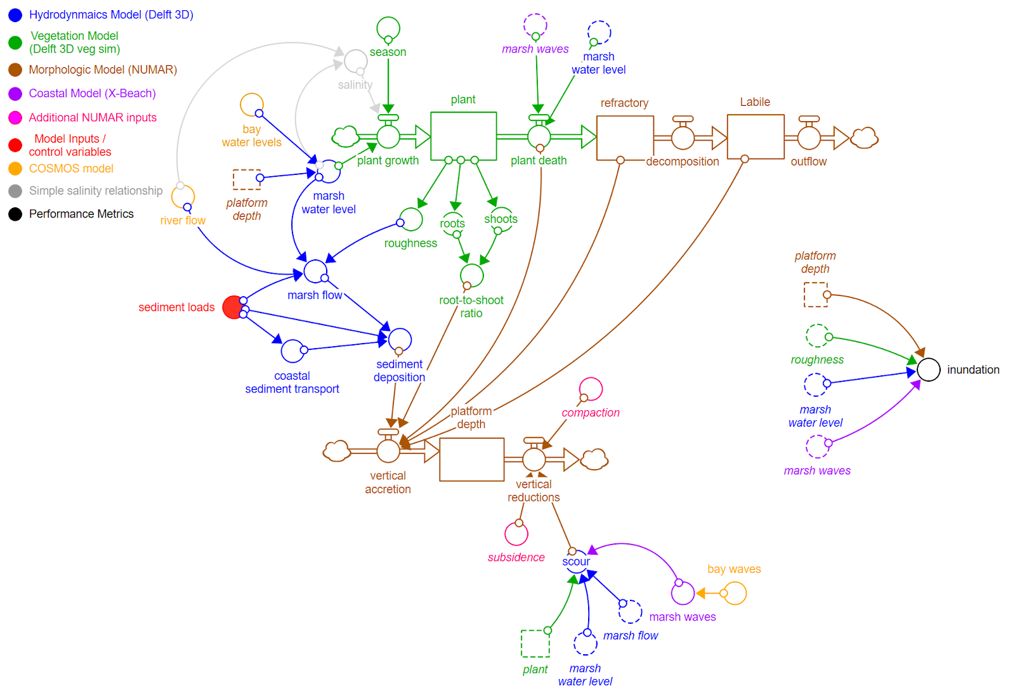
FY22 Accomplishments Hydro-Ecological Salt Marsh Model Design

Slide 22
FY22 Products
Steinschneider, Herman, Kucharski, and Abellera (submitted). Uncertainty decomposition to understand the influence of water systems model error in climate vulnerability assessments. Water Resources Research.
Mukhopadhyay, Steinschneider, Ruggiero, Kucharski (submitted). A paleo-proxy based reconstruction of still water levels in the San Francisco Bay over the past 500 years: implications for future coastal flood risk. Journal of Geophysical Research - Oceans.
Kucharski, Olszewski, Abellera, and Steissberg (2022). The Design of Constructed Salt Marshes under Deep Uncertainty. iEMSs 2022 Conference. International Environmental Modelling and Software Society. Brussels, Belgium.
Steissberg, Johnson, Zhang, Jensen, and Sanchez (2022). ClearWater-Riverine: An Integrated Water Quality Modeling Framework for Riparian and Floodplain Ecosystems. iEMSs 2022 Conference. International Environmental Modelling and Software Society. Brussels, Belgium.
Downer, Johnson, Pradhan, Zhang, and Steissberg (2022). Development of an Engineering with Nature Design Tool – Part 1: Current GSSHA Flow, Sediment, and Constituent Fate and Transport Capabilities. American Geophysical Union (AGU) Frontiers in Hydrology Conference. Session: Working with Nature-Based Features in Inland and Coastal Tropical Environments. American Geophysical Union. San Juan, Puerto Rico.

Slide 23
FY22 Products
Johnson, Downer, Steissberg, and Zhang (2022). Development of an Engineering with Nature Design Tool – Part 2: ClearWater Water Quality Modules Integration with GSSHA. American Geophysical Union (AGU) Frontiers in Hydrology Conference. Session: Working with Nature-Based Features in Inland and Coastal Tropical Environments. American Geophysical Union. San Juan, Puerto Rico.
Zhang, Steissberg, and Johnson (2022). Linked Riverine and Reservoir Hydraulic and Water Quality Modeling for Ecological Impact Assessment. American Geophysical Union (AGU) Frontiers in Hydrology Conference. Session: Working with Nature-Based Features in Inland and Coastal Tropical Environments. American Geophysical Union. San Juan, Puerto Rico.
Steissberg, Johnson, Zhang, Jensen, and Sanchez (2022). ClearWater-Riverine: A New Two-Dimensional River and Floodplain Water Quality Model. American Geophysical Union (AGU) Frontiers in Hydrology Conference. Session: Working with Nature-Based Features in Inland and Coastal Tropical Environments. American Geophysical Union. San Juan, Puerto Rico.

Slide 24
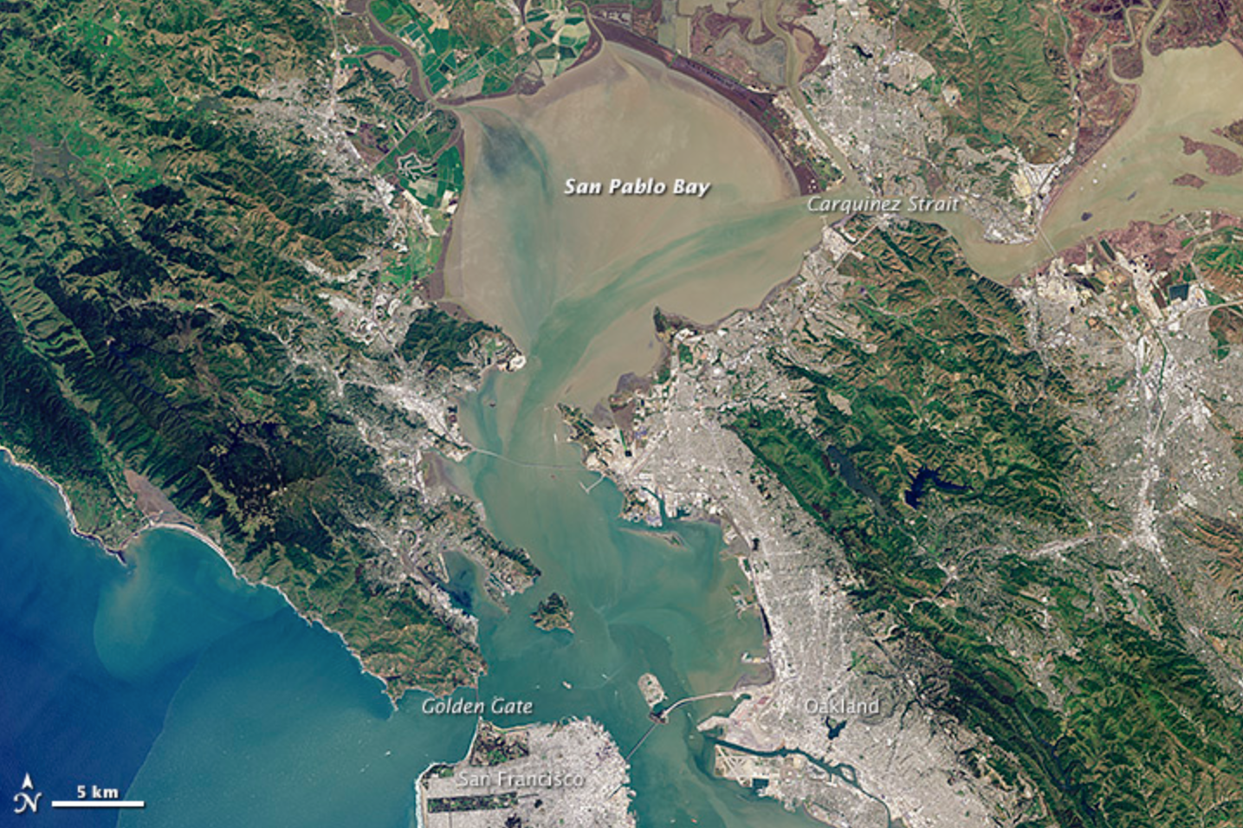
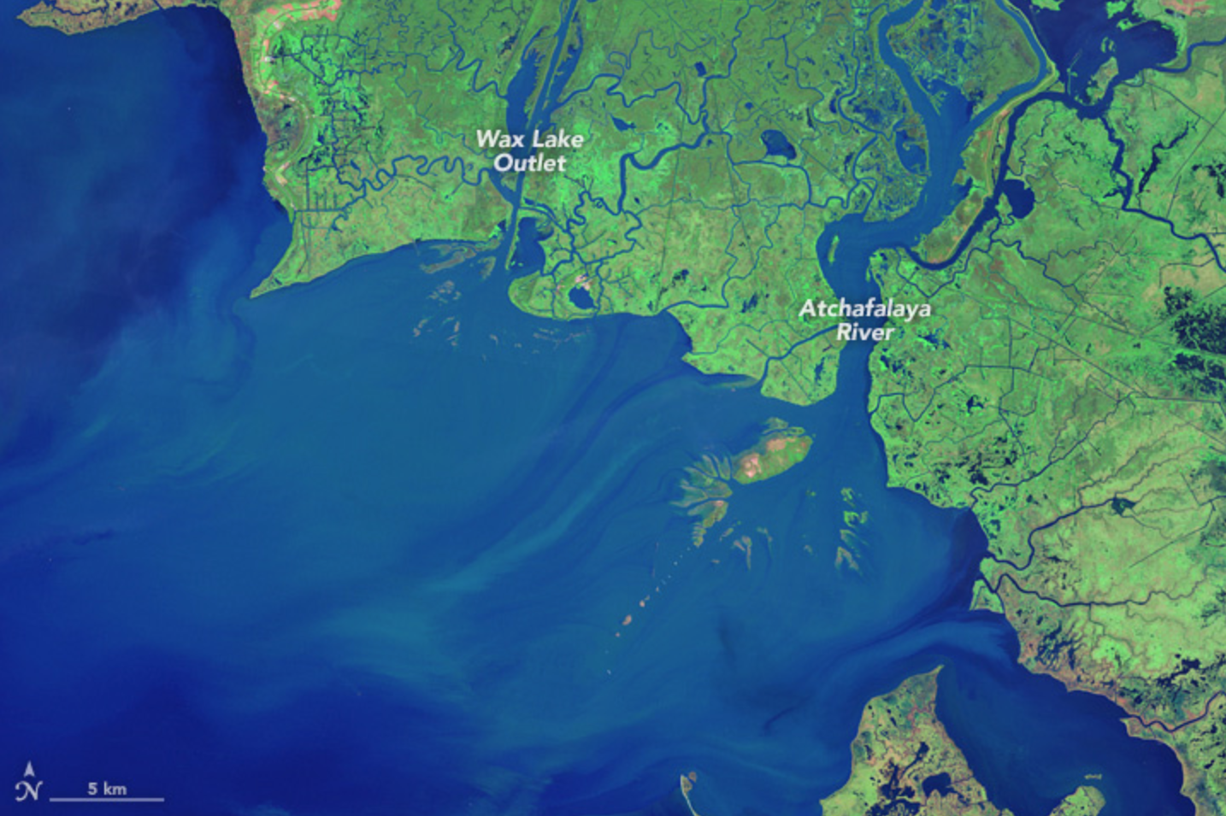
FY23 Objectives
Water Quality Modeling Case Study (Task 7)
Case Study 1: Salinity Change in the San Francisco Bay and Delta under Future Climate Scenarios, linked with COSMOS and the Weather Generator
Case Study 2: Water Quality and Salt Marsh Modeling, Atchafalaya and Terrebonne Watersheds (FY23: LSU-ERDC collaboration)

Slide 25
Post-ACTIONS Research: Hydro-Ecological Salt Marsh Model
Objective: Collaborate with LSU to further develop the landscape level salt marsh model that LSU is developing in the Atchafalaya basin.
Investigate potential use of weather generator to generate environmental (rainfall) forcings for the Atchafalaya models.
Evaluate incorporating the GSSHA model to simulate groundwater water and salinity movement (and resulting contaminant dynamics).

Slide 26
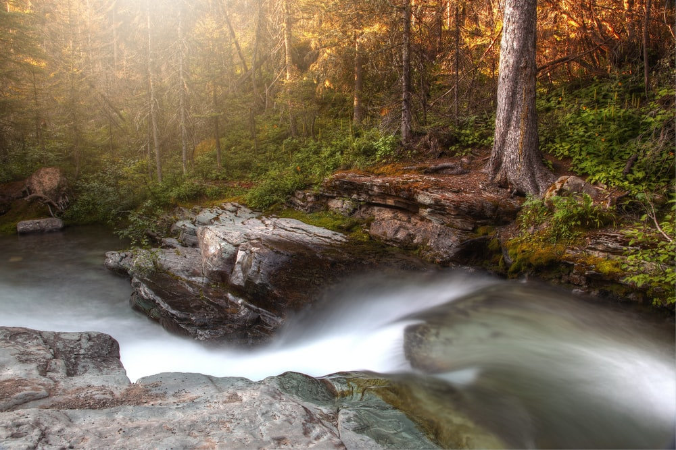
Questions?

